Slide 1
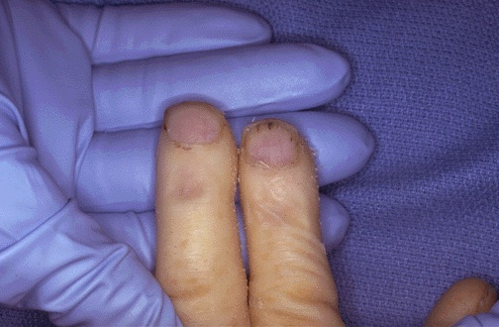
A 45-year-old homeless patient presents to your office with a 3 weeks history of progressive fatigue. On physical examination, you note the following lesions to the patient’s nail beds. Based on this finding in what other part of the physical examination should you expect to find abnormalities?
Question 1
Neck palpation for carotid artery stenosis
Lung auscultation for emphysema and polycythemia
Cardiac auscultation for systolic and diastolic murmurs
Abdominal palpation for fibromuscular hyperplasia
Rectal exam for colon cancer

Slide 2
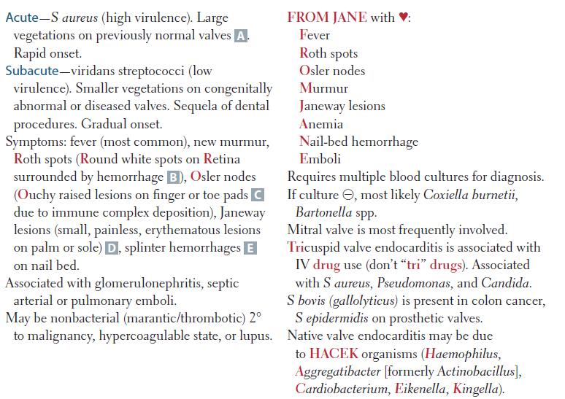
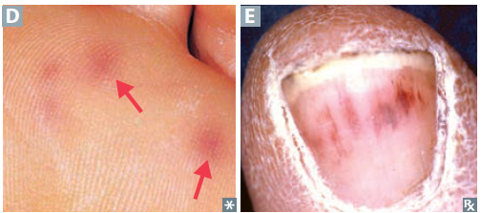
Explanations

Slide 3
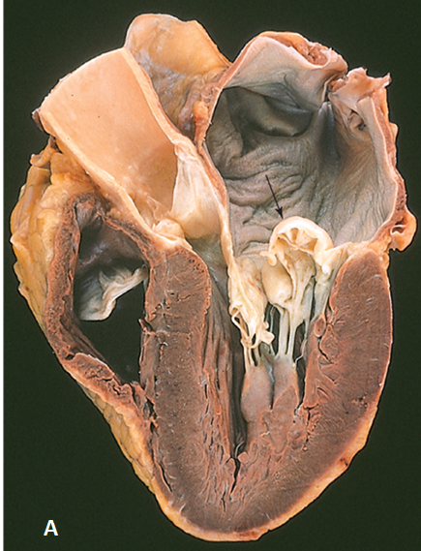
A 43-year-old woman with Marfan syndrome suffers a dissecting aneurysm of the aortic arch and expires. An abnormal mitral valve is noted at autopsy (shown in the image). Patients with this valve disorder are at greater risk for developing which of the following conditions?
Question 2
Cardiac tamponade
Cerebral embolism
Dressler syndrome
Libman-Sacks endocarditis
Ventricular aneurysm

Slide 4
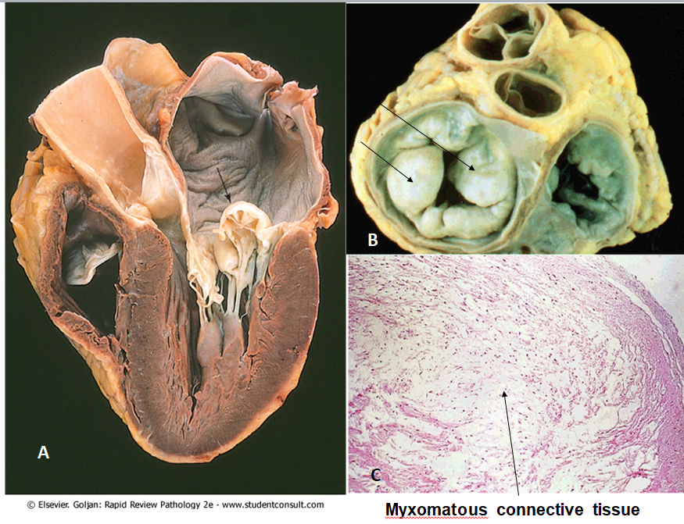
Explanations

Slide 5
Explanations

Slide 6
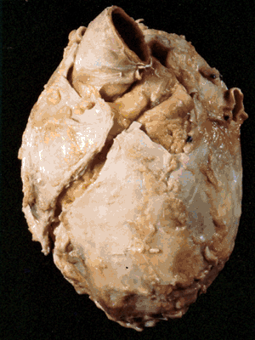
A 45-year-old male immigrant from Haiti presents with a 3-week history of difficulty breathing, chest pain, and abdominal discomfort. Physical examination shows hepatomegaly, ascites, and 2+ pitting edema of the legs. The patient was diagnosed with active pulmonary tuberculosis 2 years before. Cardiac auscultation reveals a pericardial friction rub and respiratory crackles in at the bases of both lungs. An X-ray film of the chest shows an enlarged cardiac silhouette without visible borders. The patient eventually dies and the heart at autopsy is shown in the image. What is the most likely underlying cause of death in this patient?
Question 3
Viral myocarditis
Infective endocarditis
Restrictive cardiomyopathy
Rheumatic heart disease
Constrictive pericarditis

Slide 7
Explanation

Slide 8
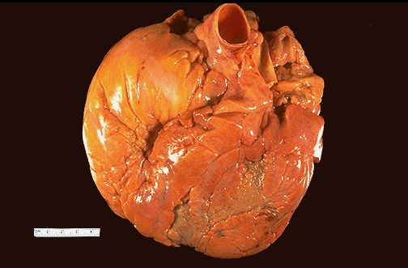
A 45-year-old man with a long history of alcohol abuse underwent heart transplantation for low output heart failure that was unresponsive to medical treatment. The affected heart at autopsy is shown in the image. It weighs 950 g (normal up to 350 g) and shows no evidence of coronary artery atherosclerosis. Histologically, the myocardium demonstrates hypertrophic myocytes and foci of myocardial fibrosis but no evidence of inflammation or myofiber disarray. Which of the following is the most likely diagnosis?
Question 4
Cardiac amyloidosis
Dilated cardiomyopathy
Hypertrophic cardiomyopathy
Restrictive cardiomyopathy
Ventricular aneurysm

Slide 9
Explanation

Slide 10
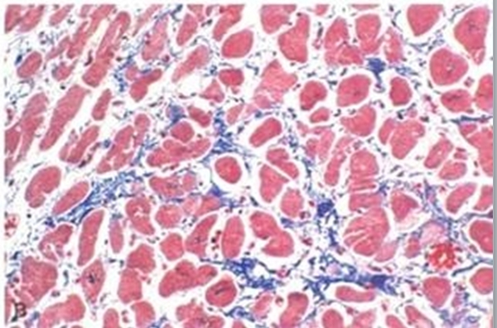
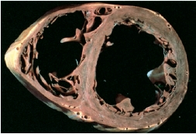
Dilated Cardiomyopathy
Is the most common cardiomyopathy
Is characterized by gradual four chamber dilation resulting in systolic failure → CHF
Etiology:
Idiopathic (MC)
Alcohol toxicity:
Direct toxic effect
Thiamine deficiency
Previous myocarditis (Coxsackie B MCC)
Cardiotoxic drugs (Doxorubicin)
Pregnancy & Postpartum state (Volume overload)
Physiologic stress (Takotsubo cardiomyopathy)
Takotsubo cardiomyopathy: broken heart syndrome—ventricular apical ballooning likely due to increased sympathetic stimulation (eg,
stressful situations).

Slide 11
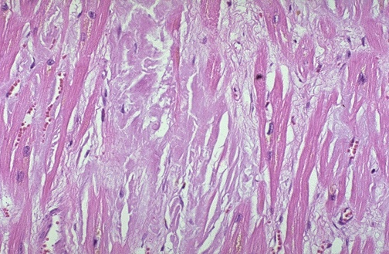
A 67-year-old man presents with increasing girth and fatigue. Physical examination reveals peripheral edema, ascites, and hepatomegaly. Liver function tests are normal. An echocardiogram shows a remarkably enlarged left and right ventricles and no signs of valvular heart disease. Left ventricular end diastolic volume is 60mL. Endomyocardial biopsy discloses interstitial, pink amorphous deposits between cardiac myocytes (shown). Which of the following is the appropriate diagnosis?
Question 5
Carcinoid heart disease
Rheumatic heart disease
Dilated cardiomyopathy
Hypertrophic cardiomyopathy
Cardiac amyloidosis

Slide 12
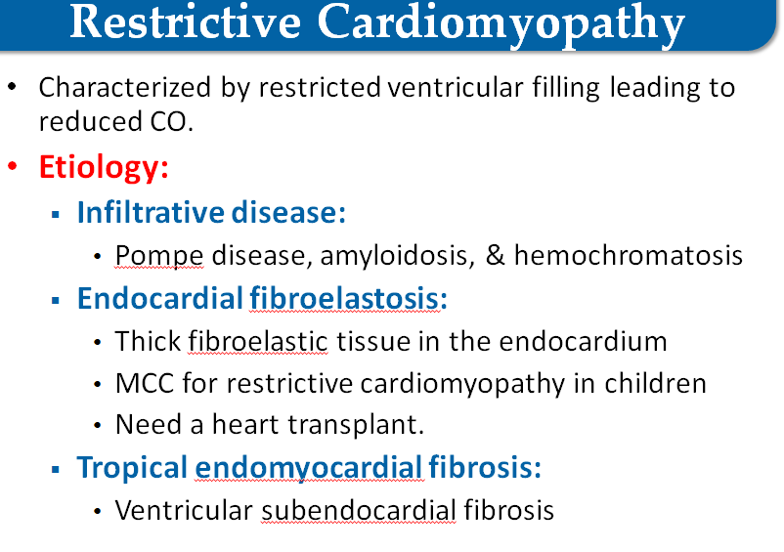
Explanation
Which findings are most likely in this patient for left ventricular ejection fraction (LVEF), left ventricular (LV) wall thickness, and left atrial pressure (LAP)?
A: LVEF would be most likely normal, LV wall would be thicker and left atrial pressure will be higher than in healthy person

Slide 13
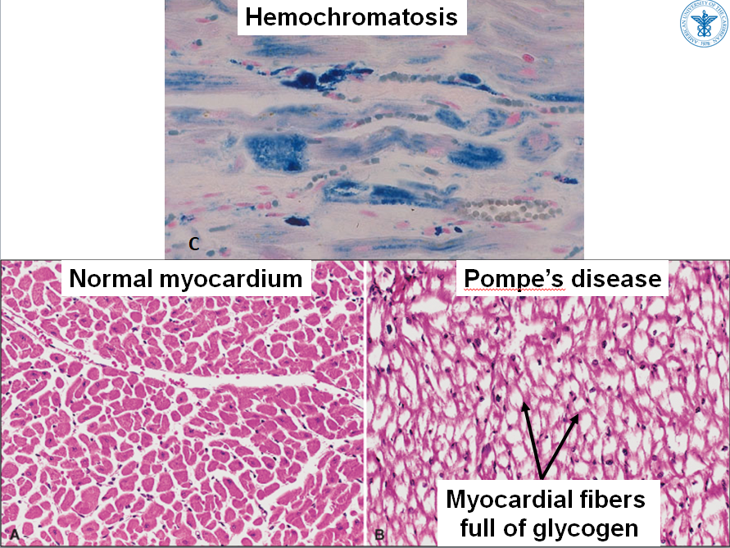
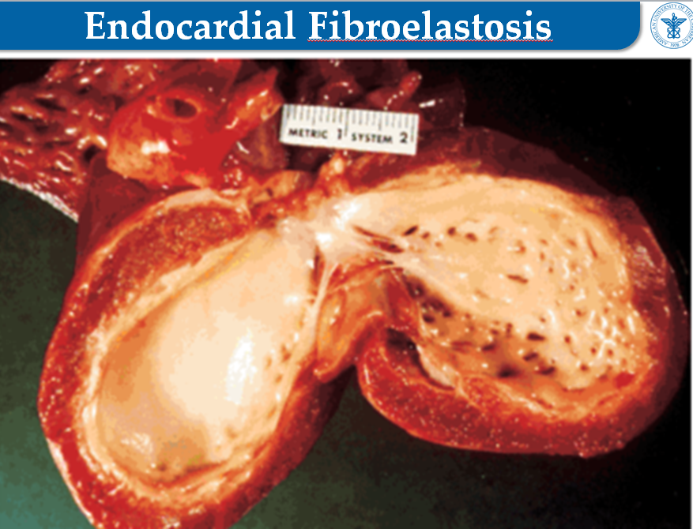

Slide 14
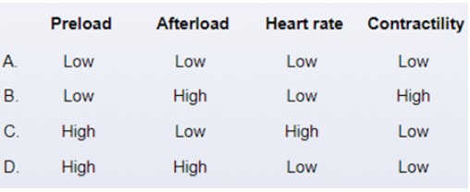
A 19-year-old college basketball player suddenly collapses on the court. A cardiac monitor shows ventricular tachycardia and then ventricular fibrillation. The patient is successfully resuscitated and hospitalized. The patient's history indicates that patient’s father died suddenly at 38 years of age. The echocardiogram reveals a thickened left ventricular wall, with a small slit-like chamber. The interventricular septum is also markedly thickened. Two years later the patient is scheduled for appendectomy. Before surgery his blood pressure is 120/80 mm Hg and pulse is 65/min. Examination shows clear lungs and a midsystolic murmur. During the period of anesthesia, which of the following sets of parameters should ideally be maintained to avoid perioperative complications?
Question 6
A
B
C
D

Slide 15
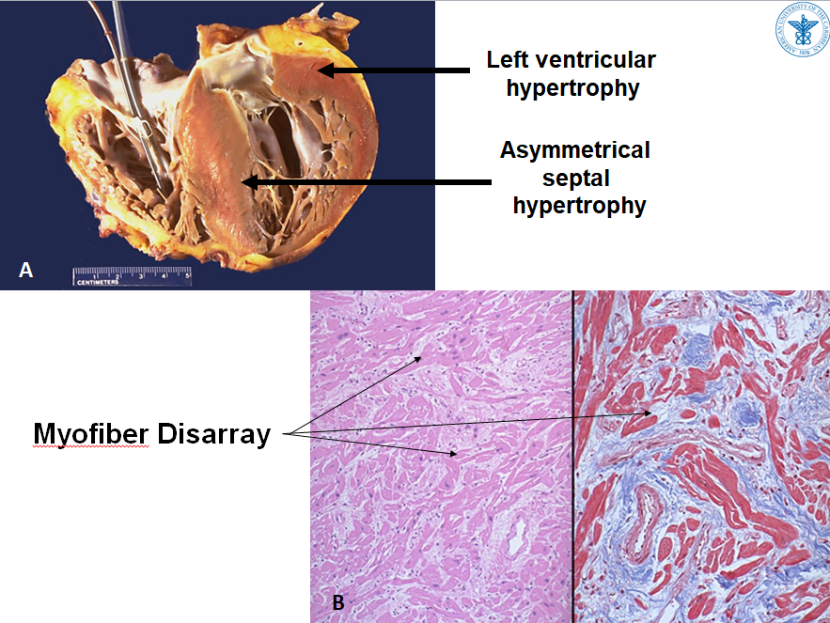
Explanation

Slide 16
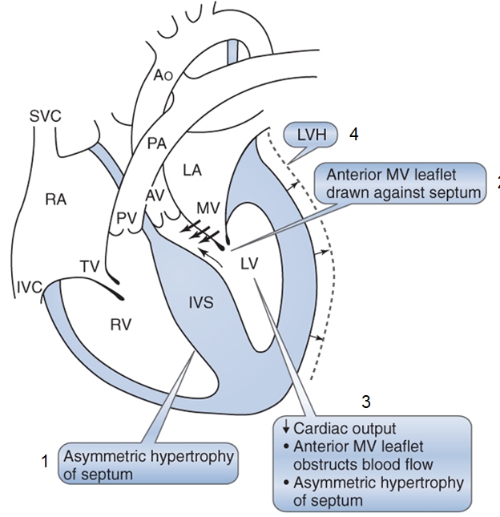

Slide 17
A 45-year-old woman presents with sudden attacks of wheezing, shortness of breath, episodic hot flashes, abdominal cramps, and diarrhea. Physical examination shows facial redness, as well as hepatomegaly and pitting edema of the lower legs. A 24-hour urine specimen reveals elevated levels of 5-hydroxyindoleacetic acid (5-HIAA). A CT scan of the abdomen demonstrates multiple 2- to 3-cm nodules throughout the liver and a 2-cm nodule in the jejunum. An echocardiogram would be most expected to demonstrate which of the following?
Question 7
Aortic stenosis
Bacterial endocarditis
Mitral valve prolapse
Nonbacterial thrombotic endocarditis
Pulmonic stenosis

Slide 18
Explanation

Slide 20
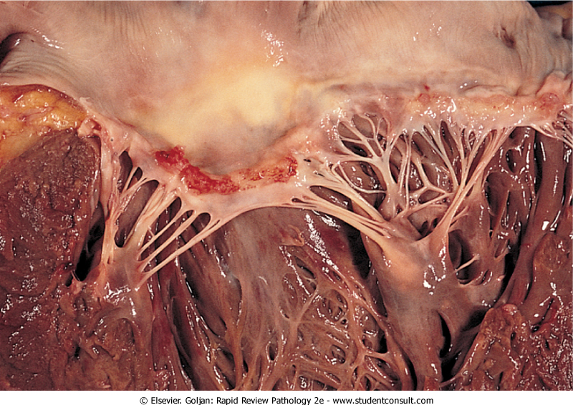
A 16-year-old girl comes to the hospital with chest pain and respiratory distress. On physical examination, the patient is short of breath, wheezing, and gasping for air. A prominent pansystolic heart murmur and a prominent third heart sound are heard on cardiac auscultation. An X-ray study of the chest shows marked enlargement of the heart. The patient expires despite intense supportive measures. Results of heart examination at autopsy is shown. What is the appropriate diagnosis?
Question 8
Acute bacterial endocarditis
Acute rheumatic heart disease
Subacute bacterial endocarditis
Systemic lupus erythematosus
Viral myocarditis
Chronic rheumatic heart disease

Slide 21
Explanation

Slide 22
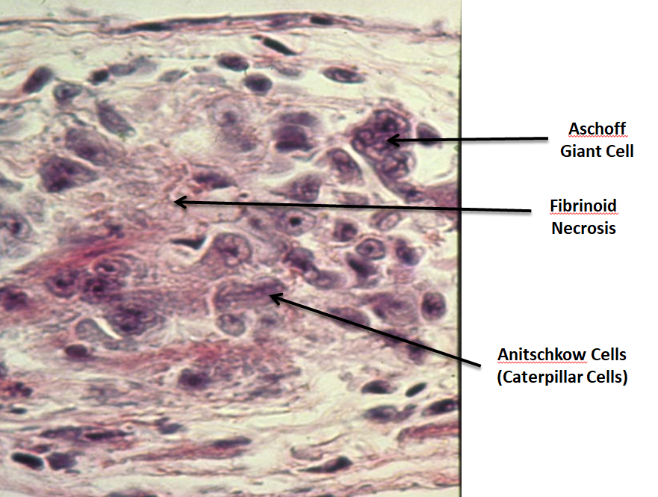
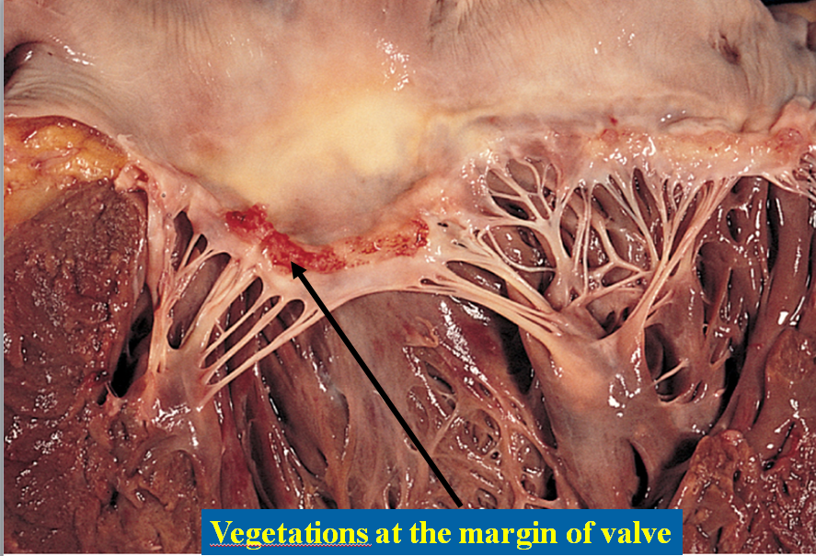

Slide 23
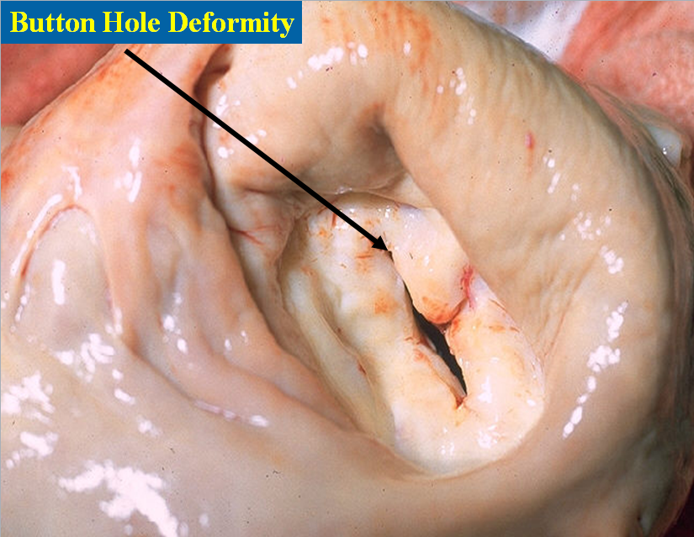
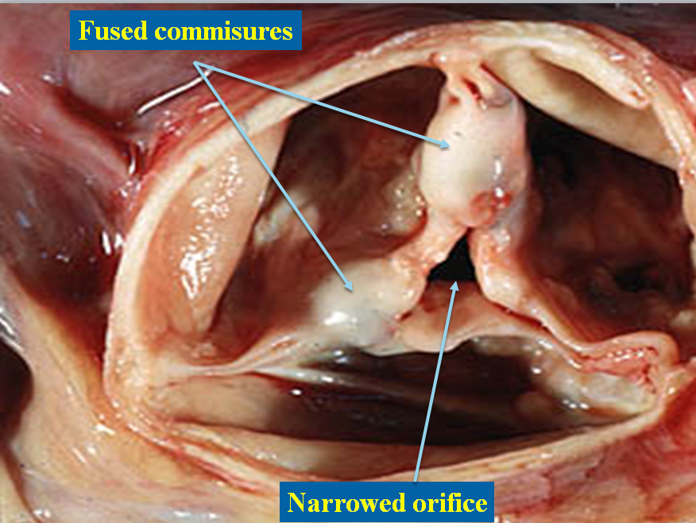
Chronic Rheumatic Heart Disease

Slide 24
A 68-year-old man comes to the office due to exertional shortness of breath and fatigue, which have progressed over the past year. The patient has a history of hypertension, but medical history is otherwise unremarkable. He is a lifetime nonsmoker. His father died of a "heart attack" at age 70. Blood pressure is 144/74 mm Hg, and pulse is 72/min and regular. Cardiac auscultation reveals a 3/6 ejection-type, late-peaking systolic murmur and a barely audible S2. The murmur diminishes in intensity during the straining phase of the Valsalva maneuver. Which of the following processes underlies this patient's current condition?
Question 9
Cardiomyocyte hypertrophy and disarray causing asymmetric septal thickening
Differentiation of valve fibroblasts into osteoblast-like cells
Myxomatous valve thickening and elastin fragmentation
Subendocardial granulomatous lesions with fibrinoid necrosis and subsequent fibrosis
Thrombus formation on inflamed valvular endothelium

Slide 25
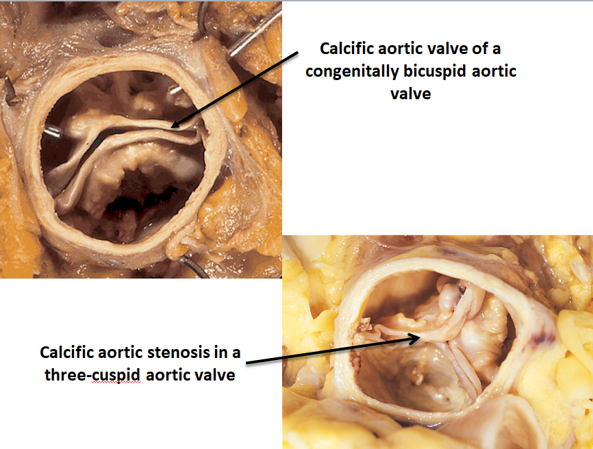
Explanation

Slide 26
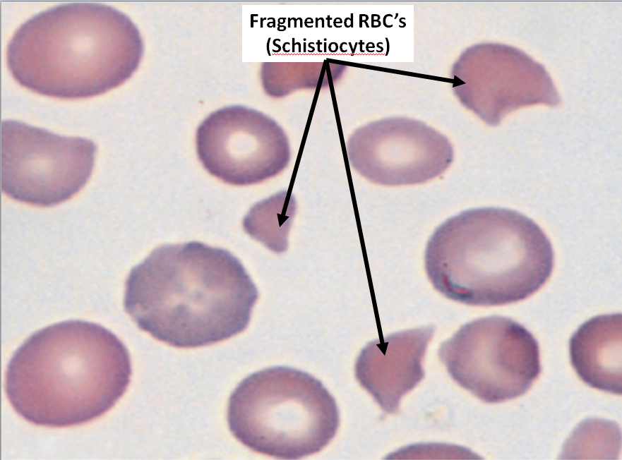

Slide 27
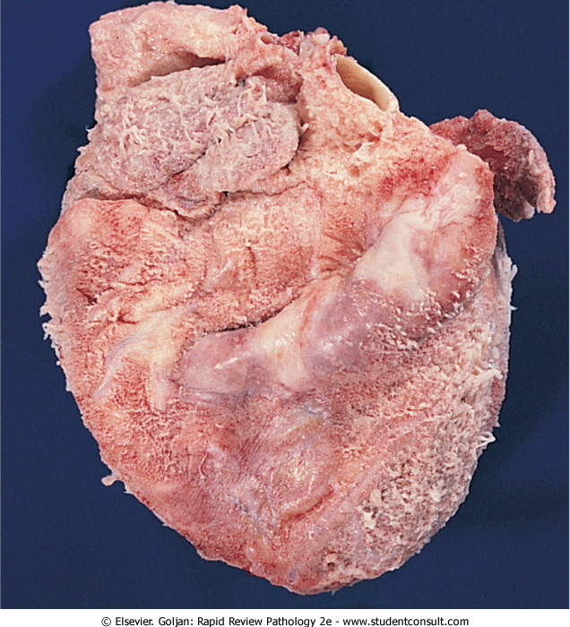
A 68-year-old man has become increasingly lethargic and weak for the past 7 months. On physical examination, his temperature is 36.9Â° C, pulse is 70/min, respirations are 15/min, and blood pressure is 160/105 mm Hg. On auscultation of his chest, a friction rub is audible. There are no other remarkable findings. The representative gross appearance of the heart is shown in the figure. Which of the following laboratory findings is most likely to be reported for this patient?
Question 10
Elevated serum anti–streptolysin O titer
Elevated plasma renin level
Increased blood urea nitrogen level
Increased serum CK-MB level
Positive ANA with “rim” pattern
Positive viral serology

Slide 28
Explanation

Slide 29
A 48-year-old, previously healthy woman reports having suddenly lost consciousness four times in the past 6 months. In three instances, she was unconsciousness for only a few minutes. After the fourth episode 1 month ago, she was unconscious for 6 hours and had weakness in her right arm and difficulty speaking. On physical examination, she is mildly febrile, her blood pressure is normal. Auscultation reveals early diastolic “plop” sound. She has good carotid pulses with no bruits. Which of the following cardiac lesions is most likely to be present in this woman?
Question 11
Bicuspid aortic valve
Coronary artery thrombosis
Left atrial myxoma
Mitral valve stenosis
Pericardial effusion

Slide 30
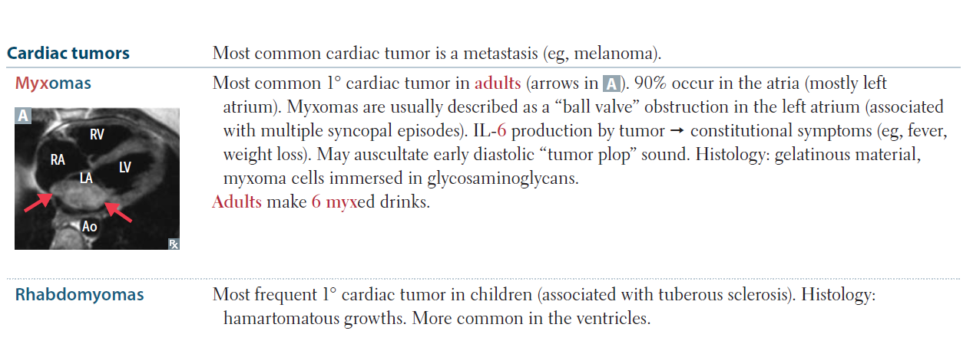
Explanation
Notes:
Incorrect answer explanationsA.Rheumatoid arthritis is a systemic inflammatory disorder that mostly affects joints. Similar to polymyalgia rheumatica, patients classically complain of pain and stiffness upon wakening. However, rheumatoid arthritis has no association with giant-cell arteritis.C.Tension headaches are usually bilateral and are describes as “squeezing” or “vice-like” and often precipitated by stress and occur at the end of the day. There is no association between tension headaches and giant-cell arteritis.D.Migraine headaches are typically described as unilateral throbbing and are associated with photophobia. There is no association between migraines and giant-cell arteritis.E.Systemic lupus erythematosus is a systemic disorder that can cause damaging inflammation almost every organ system. However, it has no association with giant-cell arteritis.F.Cluster headaches classically present as unilateral peri-ocular “stabbing” pain that occur at similar times at night for several days to weeks. There is no associated between cluster headaches and giant-cell arteritis.

Slide 32
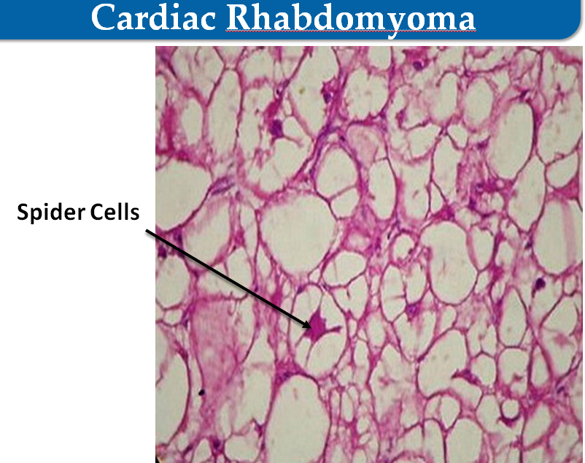
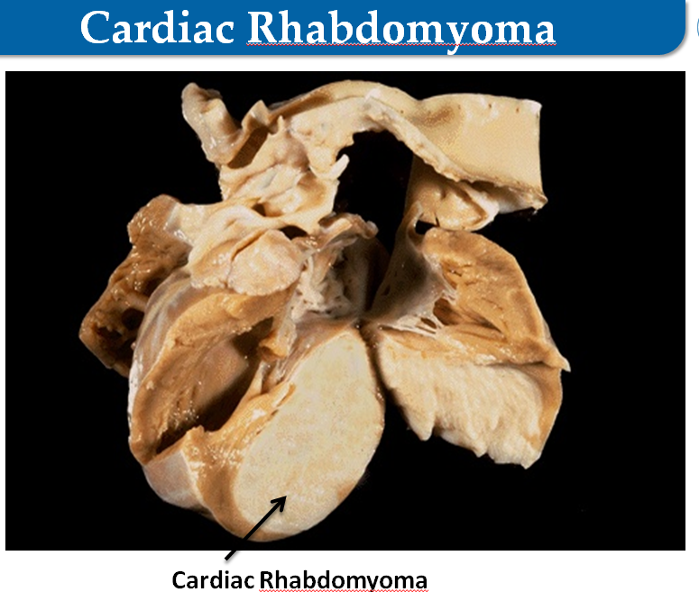

Slide 33
Questions?
Thank you!

