Slide 1
The Breast and Axilla
Inspection, Palpation
Bate’s Guide to Physical Diagnosis. 12th Edition. 2013
Merck Manual. Professional Version. https://www.merckmanuals.com/professional/
Course: Patient Doctor Skills IV
Prepared Dr. Villagomez MD; PhD

Slide 2
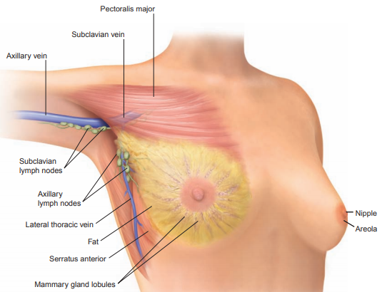
Anatomy of the Female Breast
Female breast lies against anterior thoracic wall, extending from clavicle and 2nd rib down to the 6th rib, from sternum to midaxillary line.
Surface area is rectangular, not round.
The breast overlies pectoralis major, at its inferior margin, the serratus anterior.
Hormonally sensitive, responds monthly cycling, aging. Changes depending on general state of nutrition, pregnancy, exogenous hormone use, other factors.
After menopause, there is atrophy of glandular tissue, notable decrease in number of lobules.

Slide 3
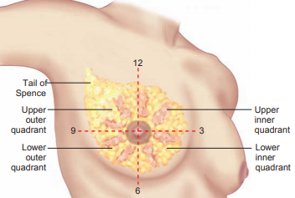
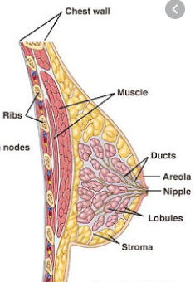
Anatomy of the Female Breast
To describe clinical findings, divided into 4 quadrants based on horizontal and vertical lines crossing nipple.
A fifth area, axillary tail of breast or “tail of Spence,” extends at anterior axillary fold. Findings can be localized as the time on the face of a clock.
Glandular tissue: secretory tubuloalveolar glands and ducts, 15-20 lobes radiating around nipple. Each lobe has smaller lobules.
Lobes drain to milk-producing ducts and sinuses that open to areola, or nipple.
Fibrous connective tissue gives support as suspensory ligaments connected to skin and underlying fascia.
Adipose tissue, or fat, surrounds breast in superficial and peripheral areas.

Slide 4
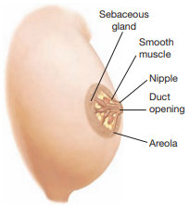
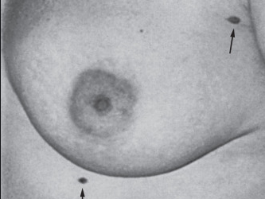
Anatomy of the Female Breast
The areola has small, round sebaceous glands, sweat glands, areolar glands.
Few hairs seen on areola. Nipple and areola has smooth muscle that contracts to express milk from ductal system during breast-feeding.
Sensory innervation in nipple, triggers “milk letdown” following neurohormonal stimulation from infant sucking
- Tactile stimulation of nipple, during breast exam may make nipple firmer, erect, areola puckered. Should not be mistaken for signs of breast disease.
Adult breast may be soft, granular, nodular, or lumpy, called physiologic nodularity. Nodularity may increase before menses, when breasts enlarge and become tender or painful.
Supernumerary nipples are located along the “milk line,” (embryonic primordia for nipples from axilla to groin). Often mistaken for a common mole. Extra nipple has no pathologic significance.
Supernumerary nipples (arrows)

Slide 5
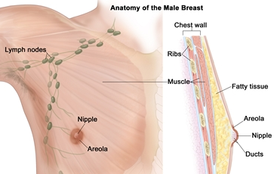
Anatomy of the Male Breast
Male breast has a small nipple and areola, thin disc of breast tissue consisting of ducts.
The lack of estrogen and progesterone stimulation, results in minimal development.
A firm button of breast tissue 2 cm or more in diameter present in one of three adult men.
Male breast cancer, rare malignancy, < 1% of cancers in men, < 1% of all breast cancers.
Incidence rising, some groups reaching 15%.
Major risk factors: advancing age, hormonal imbalance, radiation exposure, family history of breast cancer.
Most relevant risk factor, mutation BRCA2 gene.
Most cases present late because of a lack of awareness of existence of such a malignancy in males and ignorance of the related risk factors.
Males with breast cancer are at high risk for developing a second cancer.
Semin Oncol, 44 (4), 267-272 Aug 2017

Slide 6
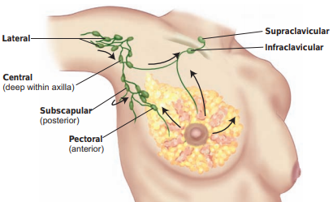
Lymphatics of the Breast
Lymphatics from most of breast drain to the axillary lymph nodes, central nodes are palpable. They are:
Pectoral nodes—anterior, lower border of pectoralis major inside anterior axillary fold. Drain anterior chest wall and breast.
Subscapular nodes—posterior, lateral border of scapula; palpated deep in posterior axillary fold. Drain posterior chest wall and arm.
Lateral nodes—along upper humerus. Drain most of arm.
Lymph drains from central axillary nodes to infraclavicular and supraclavicular nodes.
Not all lymphatics of breast drain into axilla. Malignant cells from breast cancer may spread directly to infraclavicular nodes or into the internal mammary chain of lymph nodes within the chest.

Slide 7
HEALTH HISTORY
Common or Concerning Symptoms
Breast lump or mass
Breast pain or discomfort
Nipple discharge
Ask about breasts during history or during the physical examination. Ask
“Do you examine your breasts?” . . . “How often?”
- For menstruating woman, ask when she examines her breast during her monthly cycle:
Self-examination is best done when estrogen stimulation is lowest, about 5 to 7 days after onset of menses. Ask:
“Do you have any discomfort, pain, or lumps in your breasts?”
Lumps may be physiologic or pathologic, ranging from cysts and fibroadenomas to breast cancer.

Slide 8
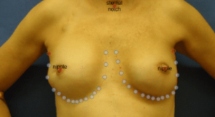
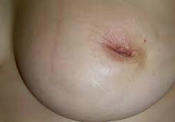
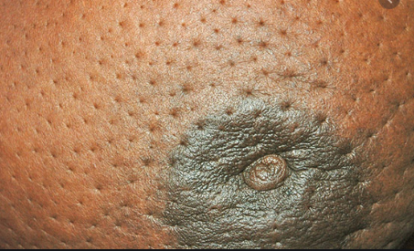
HEALTH HISTORY
Common or Concerning Symptoms
Breast lump or mass
If patient reports lump or mass, ask about
Breast contour
Location,
How long it has been present, and
Any change in size or
Variation within menstrual cycle.
Any change in breast contour, dimpling, swelling, or puckering of skin over the breasts.
Nipple puckering
Breast dimpling
Nipple discharge
- Ask about discharge from nipples and when it occurs.
Does the discharge appear only after compression of the nipple, or is it spontaneous? -
- Physiologic hypersecretion seen: pregnancy, lactation, chest wall stimulation, sleep, stress. If spontaneous, What is color, consistency, quantity? Is the color milky, brown, greenish, bloody?
- Ask if the discharge is unilateral or bilateral.
Galactorrhea, or inappropriate discharge of milk-containing fluid, is abnormal if it occurs 6 or more months after childbirth or cessation of breast-feeding.

Slide 9
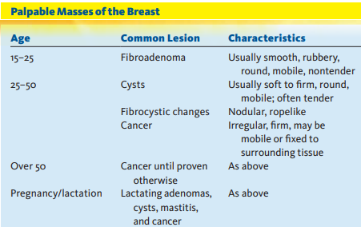
Health Promotion and Counseling
Palpable masses of the breast
Assessing risk of breast cancer
Breast cancer screening
The Clinical Breast Examination (CBE) provides an opportunity for detecting lump or masses, risk factors for breast cancer, screening measures such as breast self-examination, The CBE should be performed by a skilled clinician, followed by mammography, if needed.

Slide 10
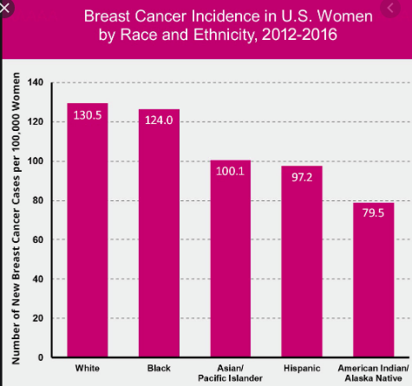
BREAST CANCER
Breast Cancer Facts and Figures.
- Breast cancer is the most common cause of cancer in women worldwide, accounting for >10% of cancers in women.
- In the United States, a woman born now has a 12%, or 1 in 8, lifetime risk of developing breast cancer.
95% of new breast cancer cases occur after age 40.
Probability of diagnosis over the next 10 years of a woman’s life increases by decade.

Slide 11
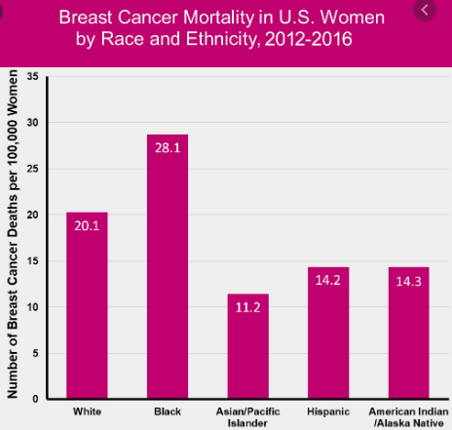
BREAST CANCER
Breast Cancer Facts and Figures 2009–2010, American Cancer Society highlights trends in breast cancer statistics.
●● Declines in new cases of invasive breast cancer since 2000. Due to decrease in use of hormone replacement therapy (HRT) in women >50, decrease in mammography screening, which means fewer cancers are detected earlier, but not actually a true decrease in disease occurrence.
●● More advanced breast cancer at earlier age in African American women. Compared to white women, African American women have higher incidence of breast cancer before age 45, are more likely to have larger tumors at diagnosis, more likely to die from breast cancer at every age.

Slide 12
Factors That Increase Relative Risk
FACTOR
RELATIVE RISK
Female
Age (65+ versus <65 years, risk increases across all ages until age 80).
Inherited genetic mutations for breast cancer (BRCA1 and/or BRCA2)
Two or more first-degree relatives with breast cancer diagnosed at an early age
Personal history of breast cancer
High breast tissue density
Biopsy-confirmed atypical hyperplasia
One first-degree relative with breast cancer
High-dose radiation to chest
High bone density (postmenopausal)
Late age at first full-term pregnancy (>30 years)
Early menarche (<12 years)
Late menopause (>55 years)
No full-term pregnancies
Never breast-fed a child
Recent oral contraceptive use
Recent and long-term use of hormone replacement therapy (HRT)
Obesity (postmenopausal)
Personal history of endometrium, ovary. or colon cancer
Alcohol consumption
Height (tall)
High socioeconomic status
>4.0
Male breast cancer constitutes 1% of breast cancer cases, peaking at age 71.
Risk factors: BRCA2 mutations, obesity, family history of male or female breast cancer, testicular disorders, work exposure to high temperatures and exhaust emission.
2.1–4.0
1.1–2.0 Factors that affect circulating hormones
Other factors

Slide 13
Breast Cancer Screening and Chemoprevention
Individualized Screening. Discussions about risk factors for breast cancer can begin at any age. Screen all women for risk factors: genetic syndromes. Ask about ovarian cancer. Decisions about how and when to screen for breast cancer involve several issues.
Mammography
Women Ages 40 to 50. Mammography for screening this age group is controversial due to lower sensitivity and specificity, high numbers of false positives, (9 out of 100 women) resulting in unnecessary invasive procedures.
Women 50 to 74 years. Mammography every 2 years, reducing harms of mammography screening by nearly half. Mammography screening performs best in this age group, with a sensitivity of 77% to 95% . Digital mammography perform better in younger women and women with higher breast density
Women over age 75. The American Cancer Society, and the American Geriatrics Society support individualized decisions about continued screening, depending on coexisting conditions and anticipated 5-year survival.
Clinical Breast Examination (CBE). American Cancer Society recommends CBE every 3 years for women ages 20 to 39, annually, beginning at age 40. CBE sensitivity and sensibility heavily influenced by technique of examiner.
Breast Self-Examination (BSE). American Cancer Society advocates BSE with mammography and to promote health awareness. Teach and review your patient’s technique.
Magnetic Resonance Imaging (MRI). Studies for screening, focused on high-risk populations;
Notes:
High breast density is common. In the U.S., 40-50 percent of women ages 40-74 have dense breasts [101-102]. Breast density varies greatly by age and weight. Dense breasts are more common in both young women and thin women. Dense breast tissue can make it harder to evaluate the results of your mammogram and may also be associated with an increased risk of breast cancer.

Slide 14
EXAMINATION OF THE BREAST

Slide 15
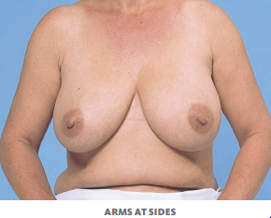
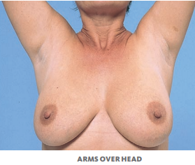
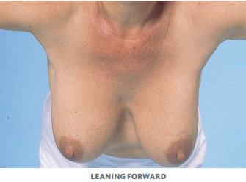
Examination of the Breast
As you begin exam, be reassuring and adopt a courteous and gentle approach.
Let patient know you are about to examine her breasts. Ask if she has noticed lumps or other problems: if she has monthly breast self-examination (BSE). If she does not, teach her.
Inspection
Inspect breasts and nipples with patient in sitting position, disrobed to the waist. Look for skin changes, symmetry, contours, retraction in four views—arms at sides, arms over head, arms pressed against hips, leaning forward. When examining an adolescent, assess breast development by Tanner’s stages.

Slide 16
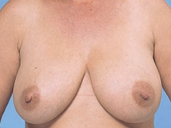
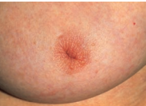
Examination of the Breast
Inspection
Redness may be from local infection, inflammatory carcinoma.
Thickening and prominent pores suggest breast cancer
Arms at Sides.
- Appearance of skin, including:
● Color
● Thickening of skin and unusually prominent pores, which may accompany lymphatic obstruction
● Size and symmetry of breasts. Difference in size and areolae, common and usually normal, as shown in the photo.
● Contour of the breasts. masses, dimpling, flattening. Compare one side with the other.
● Characteristics of nipples, size, shape, direction in they point, rashes, ulceration, discharge.
Rash or ulceration occurs in Paget’s disease of the breast.
Recent flattening or depression of nipple suggests nipple retraction. May be thickened, suggesting cancer.
Inverted nipple
Notes:
An inverted nipple is a condition in which the nipple is pulled inward into the breast instead of pointing outward. This condition can also be called nipple inversion, nipple retraction, or invaginated nipple, although some observers distinguish these two variations.

Slide 17
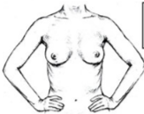
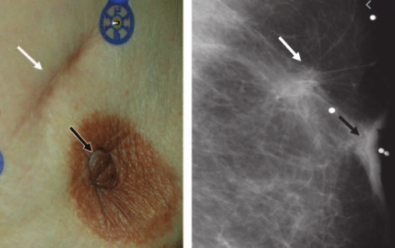
Examination of the Breast
Dimpling or retraction of breasts in these positions suggests cancer. When a cancer or its fibrous strands are attached to skin and fascia over pectoral muscles, pectoral contraction can draw skin inward, causing dimpling.
These signs may be associated with benign lesions such as posttraumatic fat necrosis or mammary duct ectasia, must always be evaluated.
Leaning forward position may reveal asymmetry of breast. Retraction of nipple and areola suggests cancer
Nipple retraction , 68-year-old woman who had lumpectomy for infiltrating ductal cell carcinoma 10 years earlier. (a) mammogram (b) show postsurgical scar (white arrow) and retracted nipple (black arrow).

Slide 18
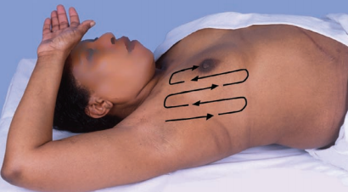
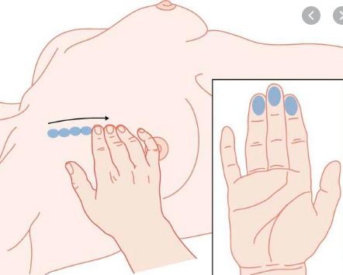
Examination of the Breast
Palpation
Best performed when breast tissue is flattened.
Patient should be supine. Palpate rectangular area extending from clavicle to inframammary fold or bra line, from midsternal line to posterior axillary line and axilla for tail of breast.
Use fingerpads of 2nd, 3rd, 4th fingers, keep fingers slightly flexed. Be systematic.
Circular or wedge pattern can be used, vertical strip pattern is the best validated technique for detection of breast masses.
Palpate in small, concentric circles, apply light, medium, deep pressure.
Press firmly to reach deeper tissues in large breasts.
Examination should cover entire breast, including periphery, tail, axilla.

Slide 19
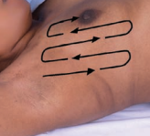
Examination of the Breast
Lateral portion of breast exam: patient rolls onto opposite hip, placing hand on forehead but keeping shoulders pressed against exam table. Begin in axilla, move in straight line to bra line, palpate in vertical strip up the chest to clavicle. Continue until you reach nipple.
To examine medial portion of breast, patient lies with shoulders flat against exam table, placing her hand at her neck, lifting up elbow until is even with her shoulder. Palpate in straight line down from nipple to bra line, then back to clavicle, continue in vertical overlapping strips to midsternum.
Examine breast tissue carefully for:
- Consistency of tissue. Normal consistency varies, depends in glandular tissue and soft fat quantity. Physiologic nodularity may be present, increasing before menses. A firm transverse ridge of compressed tissue along the lower margin of breast may be felt.
Tender cords suggest mammary duct ectasia, a benign but painful condition of dilated ducts with surrounding inflammation, or masses.
Notes:
Consistency: degree of firmness, density, viscosity, or resistance to movement

Slide 20
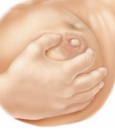
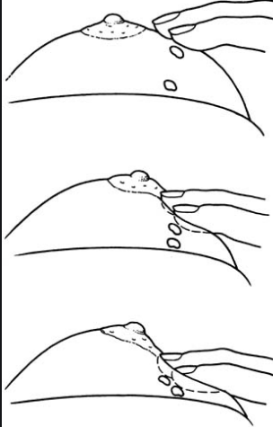
Examination of the Breast
Hard, irregular, poorly circumscribed nodules, fixed to the skin or underlying tissues, strongly suggest cancer.
Palpation
Nodules.
Palpate for lumps or mass that is different from or larger than rest of breast. It may be pathologic, needs evaluation by mammogram, aspiration, or biopsy.
Describe characteristics of nodule:
Location—by quadrant or clock, with centimeters from nipple
Size—in centimeters
Shape—round orcystic, disclike, or irregular in contour
Consistency—soft, firm, or hard
Delimitation—well circumscribed or not
Tenderness
Mobility—in relation to the skin, pectoral fascia, chest wall. Gently move breast near the mass and watch for dimpling. Next, try to move mass while patient relaxes arm and while she presses her hand against her hip.
Palpate each nipple, noting its elasticity. Press more firmly if there is a history of nipple discharge
Dimpling

Slide 21
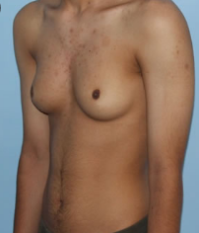
The Male Breast
Examination may be brief but important.
Inspect nipple and areola for nodules, swelling, ulceration.
Palpate areola, breast for nodules.
If breast appears enlarged, distinguish between soft fatty enlargement of obesity and firm disc of glandular enlargement, called gynecomastia.
Gynecomastia arises from imbalance of estrogens and androgens, or drug related. A hard, irregular, eccentric, or ulcerating nodule suggests breast cancer.

Slide 22
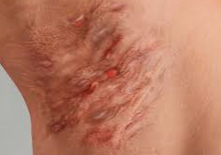
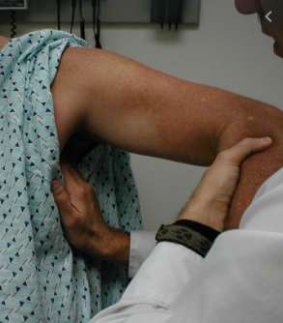
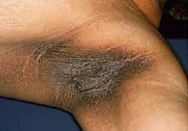
Axillae Exam
Inspection
Inspect skin of each axilla,:
●● Rash
●● Infection
●● Unusual pigmentation
Sweat gland infection (hidradenitis suppurativa)
Deeply pigmented, velvety axillary skin suggests acanthosis nigricans— one form is associated with internal malignancy.
Palpation
To examine left axilla, ask patient to relax with her left arm down.
Hidradenitis
suppurative
Supporting left hand with your left hand. Cup together ingers of your right hand reach as high as you can toward apex of axilla.
Warn patient it may feel uncomfortable.
Your fingers should lie behind pectoral muscles, pointing to the midclavicle.
Now press fingers in to the chest wall and slide them downward, trying to feel central nodes against chest wall.
Of axillary nodes, these are the most often palpable.
Acanthosis
Nigricans

Slide 23
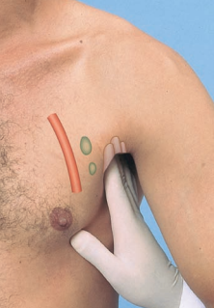
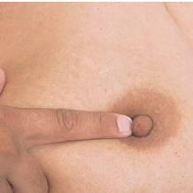
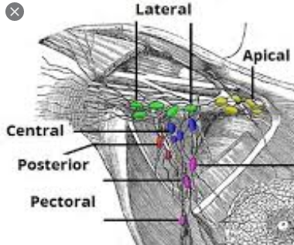
Axillae Exam
Use your left hand to examine the right axilla.
If central nodes feel large, hard, or tender, or if there is a suspicious lesion in drainage areas, feel other groups of axillary nodes:
●● Pectoral nodes: grasp anterior axillary fold between your thumb and fingers, and with your fingers, palpate inside the border of the pectoral muscle.
●● Lateral nodes: from high in the axilla, feel along the upper humerus.
●● Subscapular nodes: step behind patient, with your fingers, feel inside muscle of the posterior axillary fold
Special Techniques
Assessment of Spontaneous Discharge
Nipple Discharge. Determine origin by pressing areola with index finger, placed in radial positions around nipple. Note color, consistency, quantity and exact location where it appears.
Milky discharge unrelated to a prior pregnancy and lactation is nonpuerperal galactorrhea. Causes: hypothyroidism, pituitary prolactinoma, drugs: dopamine agonists, psychotropic agents and phenothiazines.

Slide 24
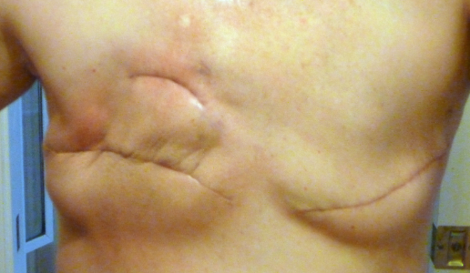
Examination of the Breast
Examination of the Mastectomy
Inspect the mastectomy scar and axilla for masses or nodularity.
Note change in color or signs of inflammation.
Lymphedema may be present in axilla and upper arm from impaired lymph drainage after surgery.
Palpate gently along the scar—these tissues may be unusually sensitive.
Use a circular motion with two or three fingers.
Pay special attention to the upper outer quadrant and axilla.
Check for enlargement of the lymph nodes or signs of inflammation or infection.

Slide 25
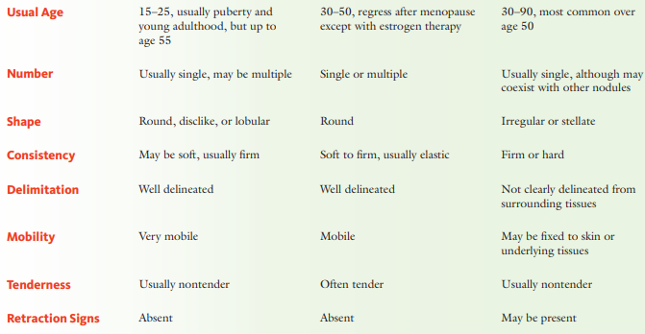
COMMON BREAST MASSES
FIBROADENOMA
CYST
CANCER

Slide 26
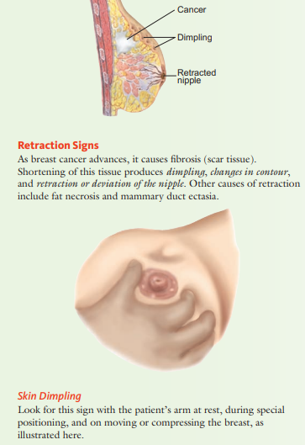
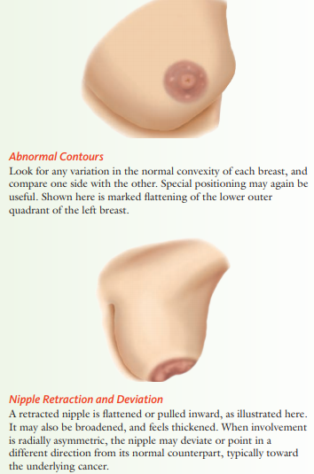
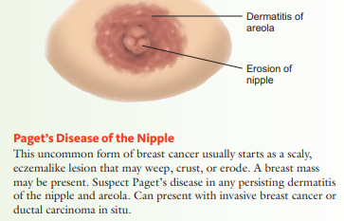
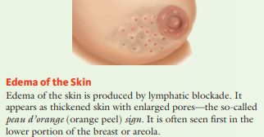
Visible Signs of Breast Cancer

Slide 27
Recording the Physical Exam
“Breasts symmetric and smooth without masses. Nipples without discharge.” (Axillary adenopathy usually included after Neck in section on Lymph Nodes; see p. 256.)
OR
“Breasts pendulous with diffuse fibrocystic changes. Single firm 1 × 1 cm mass, mobile and nontender, with overlying peau d’orange appearance in right breast, upper outer quadrant at 11 o’clock, 2 cm from the nipple.”

Slide 28
Reference
Bate’s Guide to Physical Diagnosis and History Taking. Lippincot. 11th Edition. 2013. Chapter 14.
Merck’s Manual. Professional Edition. https://www.merckmanuals.com/professional
Mosby’s Expert Physical Exam Handbook. Rapid Inpatient and Outpatient Assessments.

